Slide 1

Kazi Saeed Alam
Assistant Professor,
Department of Computer Science and Engineering,
Khulna University of Engineering & Technology (KUET).

Slide 2
Content
LaTeX Introduction
LaTeX Benefits
LaTeX Editors
First document in LaTeX
Text formatting
Custom commands
Table of Contents

Slide 3
Content
Lists
Images
Tables
Mathematics

Slide 4
LaTeX Introduction
LaTeX (pronounced either "Lah-tech" or "Lay-tech") is a
software for typesetting documents.
It's a document preparation system.
It is not a word processor, but is used as a document markup language.
It is a free, open source software.
It was originally written by Leslie Lamport and is based on the TeX typesetting engine by Donald Knuth.

Slide 5
LaTeX Benefits
It is well-suited for scientific and technical documents.
Its superior for typesetting of mathematical formulas.
It produces very high quality output, it is extremely stable, and handles complex documents easily no matter how large they are.
Its cross-referencing capabilities, its automatic numbering and generation of lists of contents, figures and tables, indexes, glossaries, and bibliographies.

Slide 6
LaTeX Benefits
It is multilingual with language-specific features.
Produces the output in PostScript, PDF, DVI, and HTML format.
It is incredibly flexible—there are templates for letters, presentations, bills, philosophy books, law texts, music scores, and even for chess game notations.
It is available for Windows, Linux, Mac OS X, and others
Its file format is plain text – readable and editable.
It will produce the same output on all operating systems.

Slide 7
LaTeX Editors (Offline)
MikTex
TeXstudio
TexLive
TeXworks
TexMaker
TeXnicCenter
Gummi
Lyx

Slide 8
LaTeX Editors (Online)
Overleaf
ShareLatex
Papeeria
CoCalc
LatexBase
LatexLab
Sciweavers
Authorea

Slide 9
Creating First Document
Command
\documentclass[a4paper, 12pt]{article}
\title{Introduction to LaTeX}
\author{Kazi Saeed Alam}
\begin{document}
\maketitle
Preamble
This is my first LaTeX document
\end{document}
Environment

Slide 10

Output in PDF Format

Slide 11
LaTeX Commands
LaTeX commands begin with a backslash, followed by big or small letters.
Commands may have arguments, given in curly braces or in square brackets.
Calling a command looks like the following:
\command[optional argument]{argument}
There could be several arguments, each of them in braces or brackets.
Arguments in curly braces are mandatory.

Slide 12
Spaces, Line Breaks, Paragraphs
\begin{document}
\maketitle
\section{Introduction} This is the
first paragraph.
This is the second paragraph.
\end{document}

Slide 13
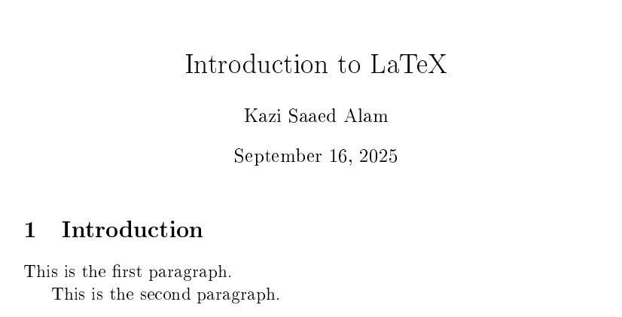
Spaces, Line Breaks, Paragraphs

Slide 14
Spaces, Line Breaks, Paragraphs and Comments
LaTeX treats multiple spaces just like a single space.
A single line break has the same effect like a single space.
It doesn't matter how you arrange your text in the editor using spaces or breaks, the output will stay the same.
A blank line denotes a paragraph break.
Multiple empty lines are treated as one.
Everything following a percent sign (% symbol used as comment) until the end of the line will be ignored by LaTeX.

Slide 15
Writing Special Characters
\section{Writing Special Characters} Statement \#1:
50\% of \$100 makes \$50.
\\
More special symbols are \&, \_, \{ and \}.
\\
\textbackslash

Slide 16
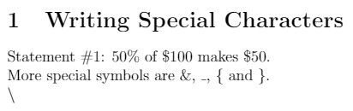
Writing Special Characters

Slide 17
Bolds, Italics and Underlining
Text can be \emph{emphasized}.\\
\textit{italic} words could be \textbf{bold}.\\
\textsl{slanted} or in \textsc{Small Caps}.\\ Commands can be \textit{\textbf{nested}}.\\
\emph{Here \emph{emphasizing} nested.}

Slide 18
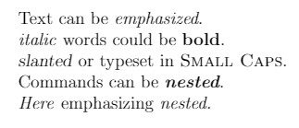
Bolds, Italics and Underlining

Slide 19
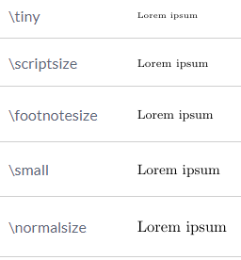
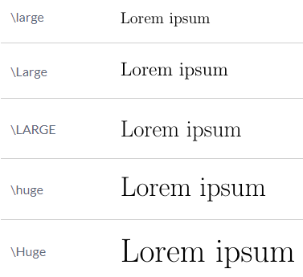
Fonts Sizes

Slide 20
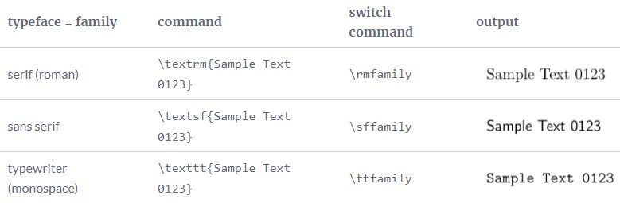
Fonts Families

Slide 21
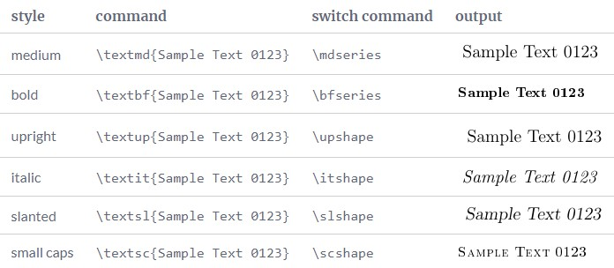
Fonts Styles

Slide 22
Text Alignments
\begin{flushleft}
This is left aligned.\\
\end{flushleft}
\begin{flushright}
This is right aligned.\\
\end{flushright}
\begin{center}
This is center aligned.\\
\end{center}
\begin{centering}
This is a justified Text.
\end{centering}

Slide 23
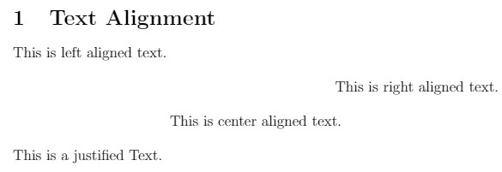
Text Alignments

Slide 24
Custom Commands
\newcommand{\TUG}{TeX Users Group}
\begin{document}
\section{Creating Custom Commands}
The \TUG\ is an organization for people who are interested in \TeX\ or \LaTeX.
\end{document}

Slide 25
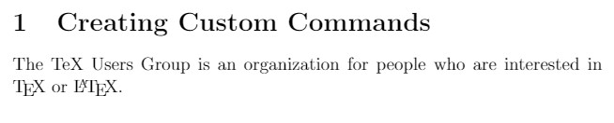
Custom Commands

Slide 26
Creating a Macro
\documentclass{article}
\newcommand{\keyword}[1]{\textbf{#1}}
\begin{document}
\section{Defining a Macro and using it}
\keyword{Grouping} by curly braces limits the
\keyword{scope} of \keyword{declarations}.
\end{document}

Slide 27

Creating a Macro

Slide 28
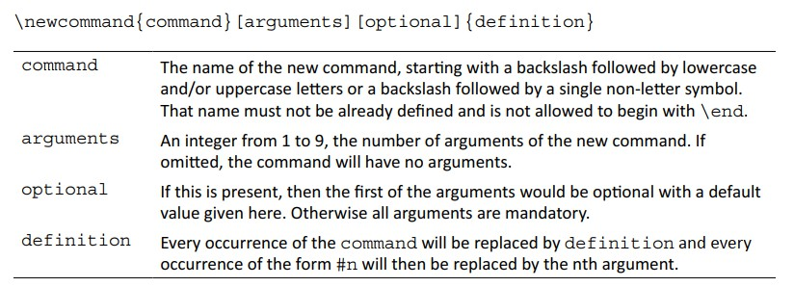
\newcommand

Slide 29
Command with Optional Arguments
\documentclass{article}
\newcommand{\keyword}[2][\bfseries]{{#1#2}}
\begin{document}
\section{Macro with Optional Arguments}
\keyword{Grouping} by curly braces limits the
\keyword{scope} of
\keyword[\itshape]{declarations}.
\end{document}

Slide 30

Command with Optional Arguments

Slide 31
Two Columns
\documentclass[a4paper,12pt]{article}
\usepackage[english]{babel}
\usepackage{blindtext}
\begin{document}
\twocolumn
\blindtext[5]
\end{document}

Slide 32
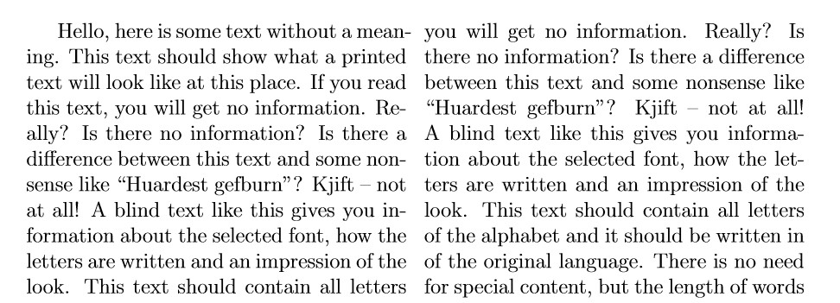
Two Columns (Output)

Slide 33
Multiple Columns
\documentclass{article}
\usepackage{blindtext}
\usepackage{multicol}
\begin{document}
\begin{multicols}{3} [
\section{Multiple Columns Example} This is a document with 3 columns.
]
\blindtext[2]
\end{multicols}
\end{document}

Slide 34
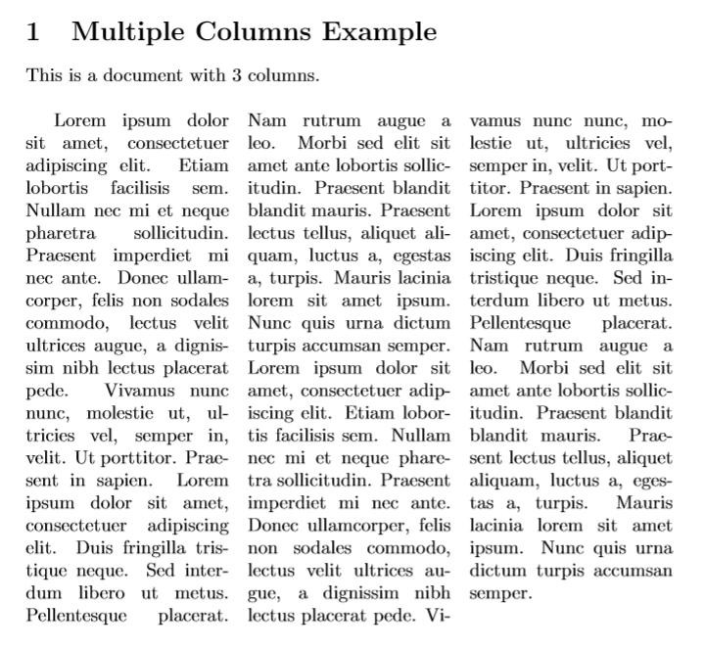

Slide 35
Table of Contents
\documentclass[a4paper,12pt]{book}
\usepackage[english]{babel}
\usepackage{blindtext}
\usepackage[a4paper, inner=1.5cm, outer=3cm, top=2cm, bottom=3cm,
bindingoffset=1cm] {geometry}
\begin{document}
\tableofcontents
\chapter{Exploring the page layout}
In this chapter we will study the layout of pages.
\section{Some filler text}
\blindtext
\section{A lot more filler text}
More dummy text will follow.
\subsection{Plenty of filler text}
\blindtext[10]
\end{document}

Slide 36
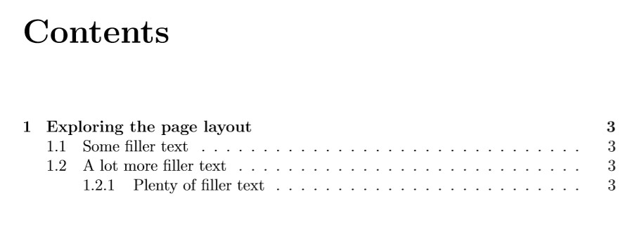
Table of Contents (First Page Output)

Slide 37
Lists in LaTeX
Various types of list in LaTeX:
itemize environment for creating a bulleted (unordered) list
enumerate environment for creating a numbered (ordered) list
description environment for creating a list of descriptions

Slide 38
Unordered List
\section{Creating an Unordered List} Lists are easy to create:
\begin{itemize}
\item start with the \verb|\item| command.
\item Entries start with bullets.
\item The text may be of any length.
\end{itemize}

Slide 39
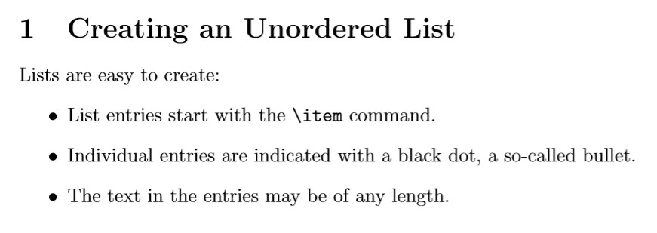
Unordered List (Output)

Slide 40
Ordered List
\begin{enumerate}
\item Items are numbered automatically.
\item start at 1 with each \texttt{enumerate}.
\item Another entry in the list
\end{enumerate}

Slide 41
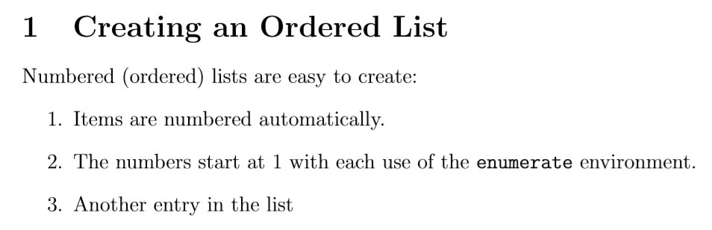
Ordered List (Output)

Slide 42
Description List
\begin{description}
\item This is an entry \textit{without} a label.
\item[Something short] A short one-line description.
\item[Something long] A much longer description.
\blindtext[1]
\end{description}

Slide 43
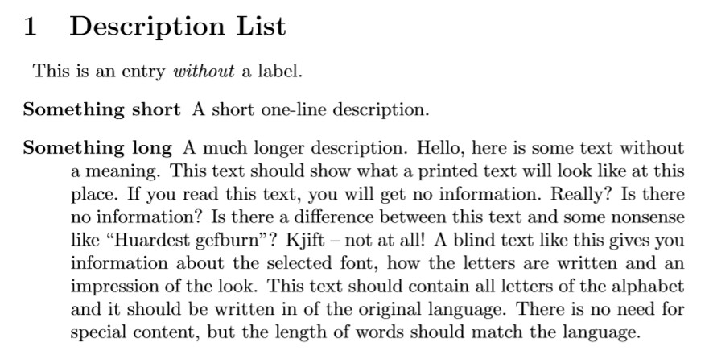
Description List (Output)

Slide 44
Inserting Images
\documentclass[a4paper, 12pt]{article}
\usepackage{graphicx}
\graphicspath{ {./images/} }
\begin{document}
\section{Inserting Images in a document}
The universe is immense and it seems to be homogeneous, in a large scale, everywhere we look at.
\includegraphics{galaxy}
There's a picture of a galaxy above
\end{document}

Slide 45
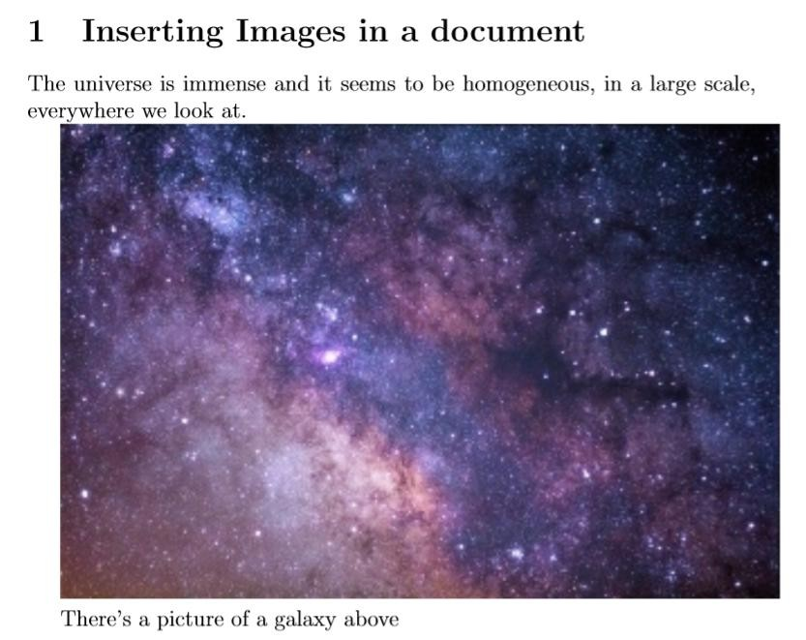
Image by StockSnap from Pixabay

Slide 46
Changing the image size and rotation
\includegraphics[scale=0.5, angle=45]{galaxy}

Slide 47
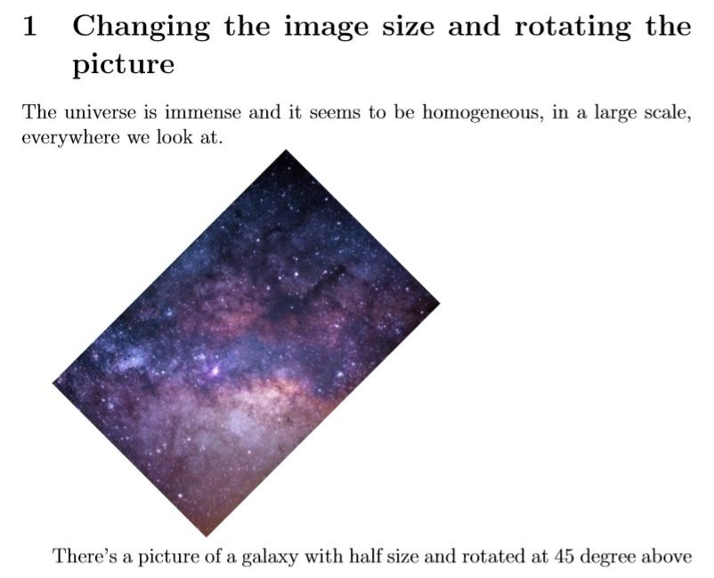

Slide 48
Creating Tables
\begin{center}
\begin{tabular}{ c c c } cell1 & cell2 & cell3 \\ cell4 & cell5 & cell6 \\ cell7 & cell8 & cell9
\end{tabular}
\end{center}
\begin{center}
\begin{tabular}{ |c|c|c| }
\hline
cell1 & cell2 & cell3 \\ cell4 & cell5 & cell6 \\ cell7 & cell8 & cell9 \\
\hline
\end{tabular}
\end{center}

Slide 49
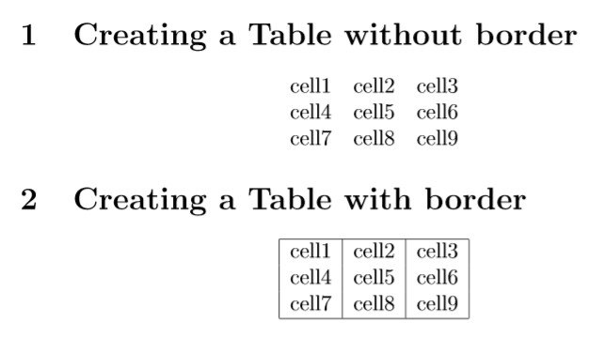

Slide 50
Combining Columns
\begin{center}
\begin{tabular}{ |c|c|c|c| }
\hline
\multicolumn{3}{|c|}{Combined Columns}\\
\hline
col1 | & | col2 | & | col3 | \\
col4 | & | col5 | & | col6 | \\
col7 | & | col8 | & | col9 | \\
\hline
\end{tabular}
\end{center}

Slide 51
Combining Rows
\usepackage{multirow}
\begin{tabular}{ |c|c|c|c| }
\hline
col1 & col2 & col3 \\
\hline
\multirow{3}{4em}{Multiple row} & cell2 & cell3 \\ & cell5 & cell6 \\
& cell8 & cell9 \\
\hline
\end{tabular}

Slide 52
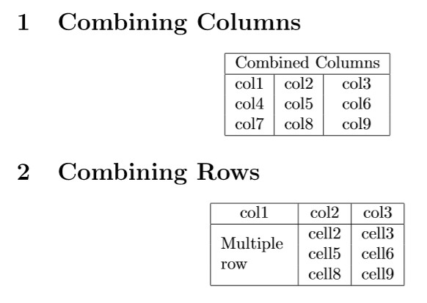

Slide 53
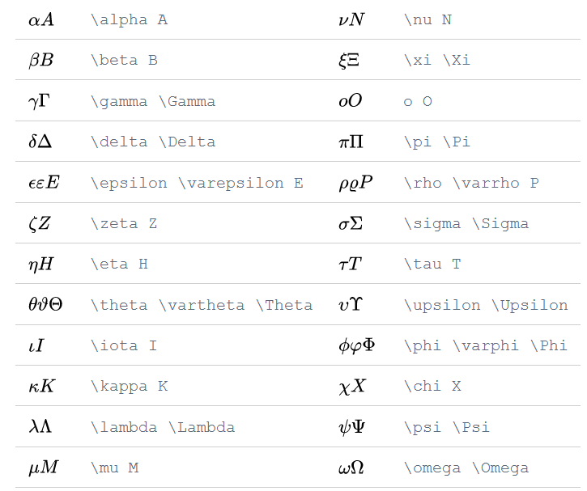
Greek Letters

Slide 54
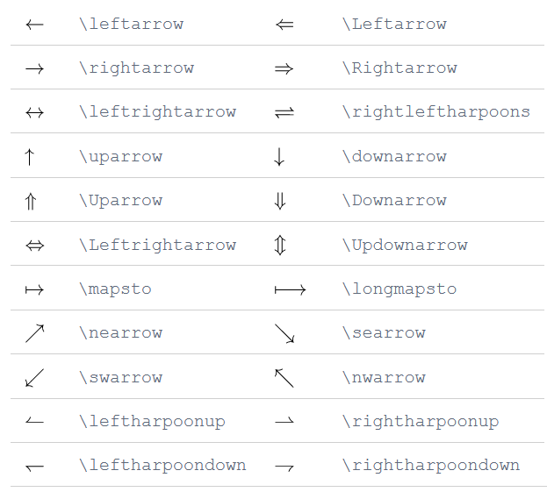
Arrows

Slide 55
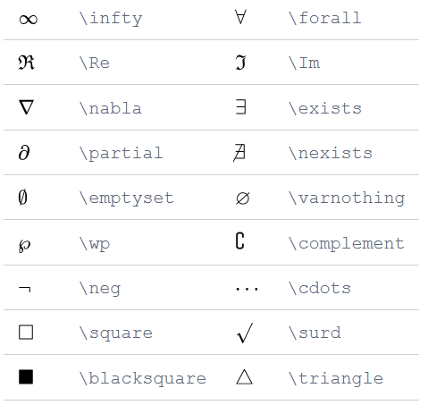
Miscellaneous symbols

Slide 56
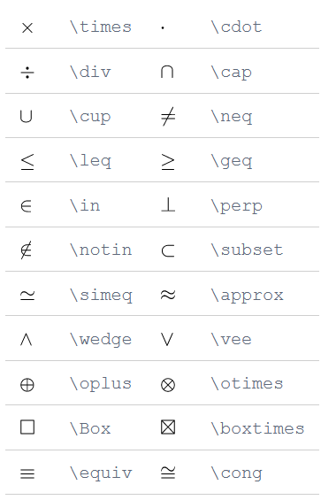
Binary Operation/ Relation Symbols

Slide 57
Mathematical Modes
LATEX allows two writing modes expressions:
for mathematical
inline math mode is used to write formulas that are part of a paragraph
display math mode is used to write expressions that are not part of a paragraph, and are therefore put on separate lines

Slide 58
Inline Math Mode
You can use any of these "delimiters" to typeset your math in inline mode:
\(...\)
$...$
\begin{math}...\end{math}

Slide 59
Display Math Mode
Use one of these constructions:
\[...\]
\begin{displaymath}...\end{displaymath}
\begin{equation}...\end{equation}

Slide 60
Mathematical Expressions
\begin{document}
The Pythagorean theorem \(x^2 + y^2 = z^2\) was proved to be invalid for other exponents.
Meaning the next equation has no integer solutions:
\[ x^n + y^n = z^n \]
\end{document}

Slide 61
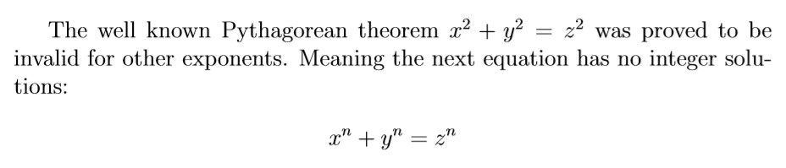

Slide 62
Display Math Mode (with equation number)
The mass-energy equivalence is described by the equation
\begin{equation} E=mc^2
\end{equation}
discovered in 1905 by Albert Einstein.
\begin{equation} E=m
\end{equation}

Slide 63
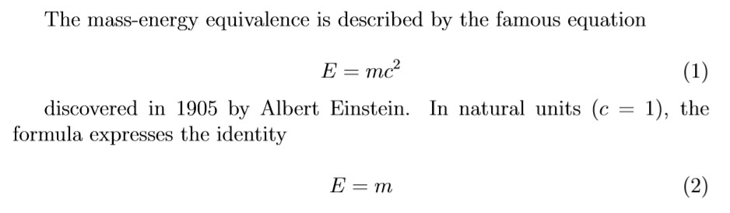
Display Math Mode (with equation number)

Slide 64
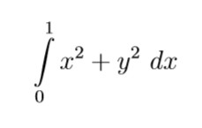
Subscript and Superscript
\[ \int\limits_0^1 x^2 + y^2 \ dx \]

Slide 65
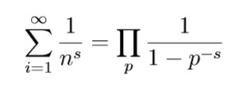
Operators using subscripts and superscripts
\[ \sum_{i=1}^{\infty} \frac{1}{n^s}
= \prod_p \frac{1}{1 - p^{-s}} \]

Slide 66
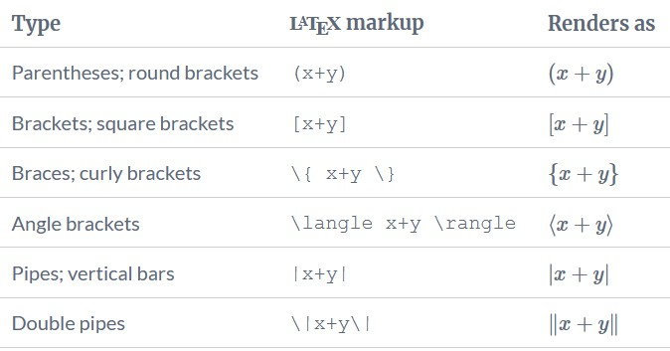
Brackets and Parentheses

Slide 67
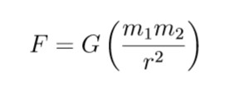
Brackets and Parentheses
\[
F = G \left( \frac{m_1 m_2}{r^2} \right)
\]

Slide 68
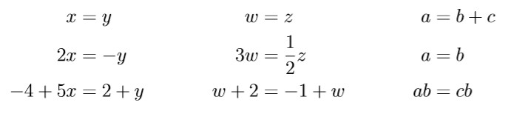
Aligning Equations with amsmath package
\begin{align*}
x&=y | & | w | &=z | & | a&=b+c\\
2x&=-y | & | 3w&=\frac{1}{2}z |  | & | a&=b\\
-4 + 5x&=2+y | & | w+2&=-1+w |  | & | ab&=cb
\end{align*}

Slide 69
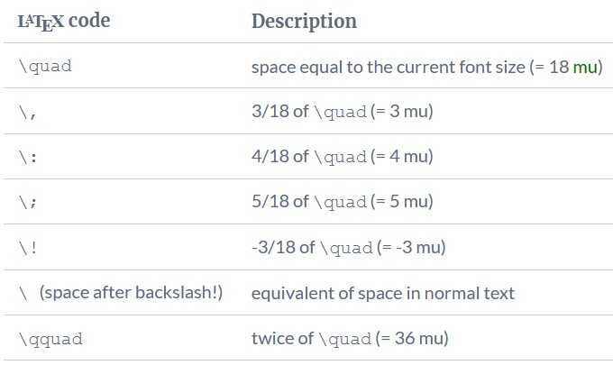
Spacing Commands (use amsmath package)

Slide 70
Spacing Commands (Example)
\begin{align*}
f(x) | &= | x^2\! +3x\! +2 \\
f(x) | &= | x^2+3x+2 \\
f(x) | &= | x^2\, +3x\, +2 \\
f(x) | &= | x^2\: +3x\: +2 \\
f(x) | &= | x^2\; +3x\; +2 \\
f(x) | &= | x^2\ +3x\ +2 \\
f(x) | &= | x^2\quad +3x\quad +2 | \\
f(x) | &= | x^2\qquad +3x\qquad | +2
\end{align*}

Slide 71
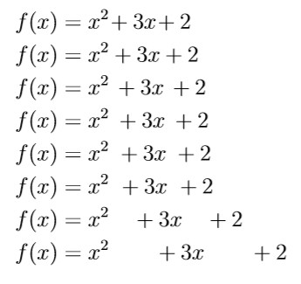
Spacing Commands (Output)

Slide 72
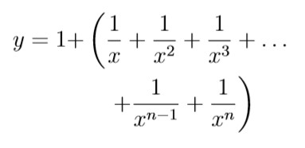
Invisible Brackets (\left. and \right.)
\usepackage{amsmath}
\begin{align*}
y = 1 + & \left( \frac{1}{x} + \frac{1}{x^2} + \frac{1}{x^3} +
\ldots \right. \\
&\left. \quad + \frac{1}{x^{n-1}} + \frac{1}{x^n} \right)
\end{align*}
Use of align* environment for not numbering the equations.
Use of ‘&’ symbol for aligning the multiple equations.

Slide 73
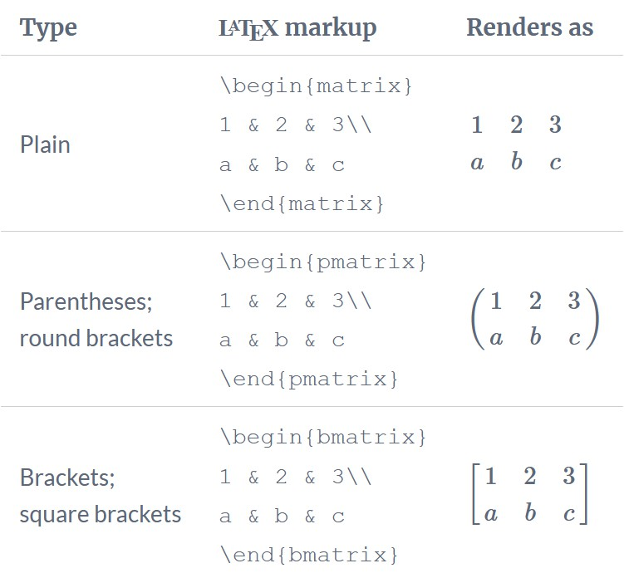
amsmath matrix environments

Slide 74
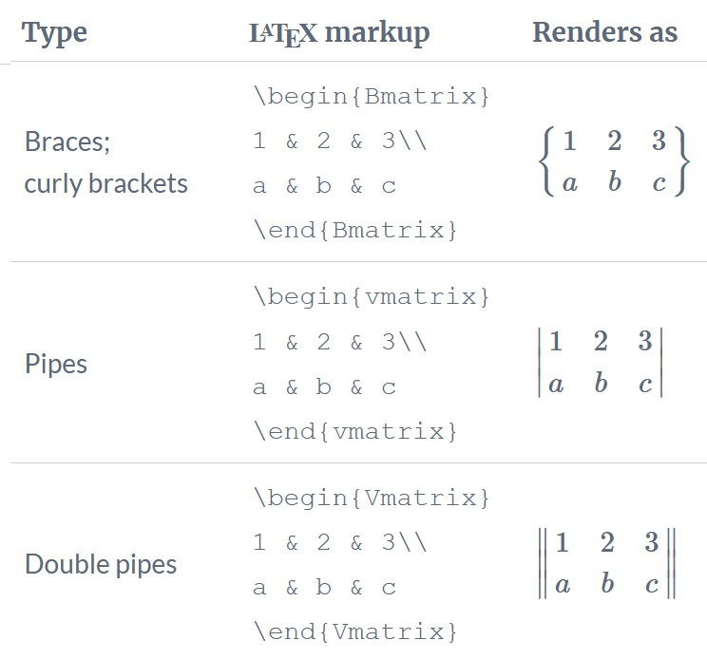
amsmath matrix environments

Slide 75
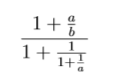
Continued Fractions
\[
\frac{1+\frac{a}{b}}{1+\frac{1}{1+\frac{1}{a}}}
\]

Slide 76
References
LaTeX Beginner’s Guide, Stefan Kottwitz, PACKT Publishing
https://www.overleaf.com/learn
https://ctan.org/tex- archive/info/lshort/english/?lang=en

